Slide 1


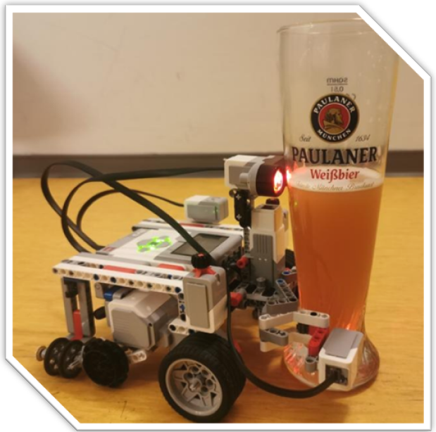
Sprint 2 Review
Lasting, efficient and fast bots
Product owner:
ENCARNACIÓN NÚÑEZ ORTEGA
SCRUM master:
LAURA PONCE OROZCO
Development team:
LAURA PONCE OROZCO
ENCARNACIÓN NÚÑEZ ORTEGA
FERLANDO MKIVA
Notes:
We updated a new product owner.

Slide 2

User stories in this sprint
As a user, I don’t want the robot to return to the home zone without the fruit grabbed.
As a user, I want the robot to look for the specified fruit and check if the fruit is correctly grabbed.
As a user, I want the robot to place the right fruit in the home zone.
As a user, I want the robot to be completely autonomous.

Slide 3

Product Backlog
OPEN
DOING
12
1
As a developer, I want the robot to keep count of the harvested fruits
As a user, I want the robot to be completely autonomous
1
1
As a user, I want the robot to immediately return to the starting point after collecting two fruits within 5 minutes
DONE
As a developer, I want the robot to be able to detect a 2.5cm cube
15
1
As a user, I don’t want the robot to return to the home zone without the fruit grabbed
4
As a user, I want the robot to place the right fruit in the home zone
As a user, I don’t want the robot to search for fruits outside the acre
4
3
3
As a user, I want the robot to ask me for the correct fruit and to confirm that it understood me
As a user, I want the robot to look for the specified fruit and check if the fruit is correctly grabbed
As a developer, I want the code to be efficient
4
2
5

Slide 4
Velocity chart
12
Planned coffees
Finished coffees
12
8
4
0
11
We have underestimated the tasks
Expected
Done
Changes
SPRINT 1
SPRINT 2
SPRINT 3

Slide 5
Planned/Actual effort
Overestimated
As a user, I want the robot to place the right fruit in the home zone.
3
2
As a user, I don’t want the robot to return to the home zone without the fruit grabbed.
Underestimated
4
5
As a user, I want the robot to look for the specified fruit and check if the fruit is correctly grabbed.
5
5
As a user, I want the robot to be completely autonomous.
1
1

Slide 6
Burn-down charts
12
8
4
0
28
24
20
16
12
8
4
0
COFFEES
COFFEES
1 2 3 4 5 6 7
1 2 3
DAYS
SPRINTS

Slide 7
Test
Robot does not lose the fruit during approach.
Differentiation between correct and incorrect fruit.
Tested different fruit positions.
Robot does not return to the home zone without the fruit
.
Notes:
.

Slide 8
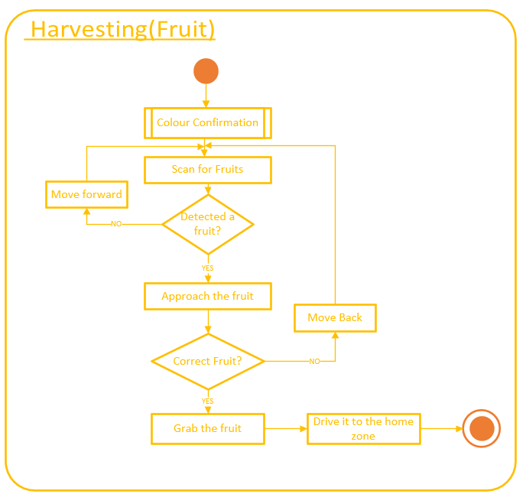
Activity Diagram
As a user, I want the robot to ask me for the correct fruit and to confirm that it understood me.
As a user, I don’t want the robot to return to the home zone without the fruit grabbed.
2
4
As a user, I want the robot to look for the specified fruit and check if the fruit is correctly grabbed.
As a user, I want the robot to place the right fruit in the home zone.
5
3

Slide 9
Activity Diagram
As a user, I want the robot to ask me for the correct fruit and to confirm that it understood me.
As a user, I don’t want the robot to return to the home zone without the fruit grabbed.
2
5
As a user, I want the robot to look for the specified fruit and check if the fruit is correctly grabbed.
As a user, I want the robot to place the right fruit in the home zone.
5
2

Slide 10
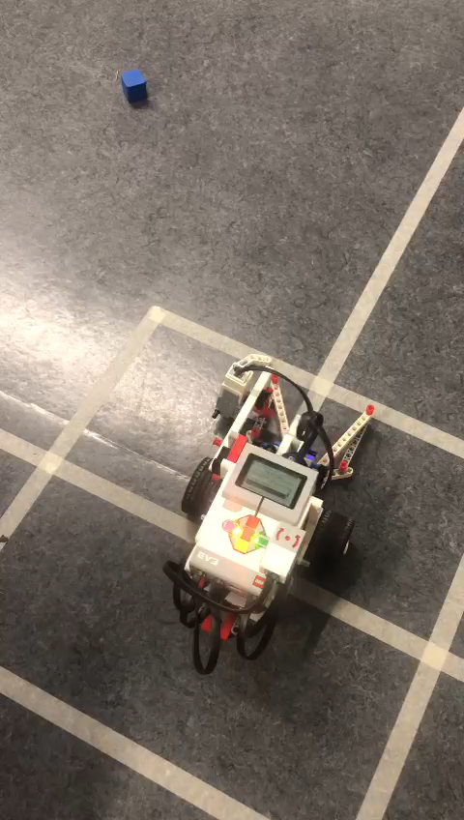
Demo

Slide 11
Retrospective
Lowlight
We wasted a lot of time trying to do something in a specific way instead of trying new ideas.
Highlight
We learned how each group member works and we took advantage of that.
Notes:
Highlight
At first we worked separately, and then we realized that we work better in one screen, because we can all see the code at the same time and detect the errors.

Slide 12
SMART goal
Specific
Measurable
Achievable
Relevant
Time-Bound
Our goal is to improve our code accuracy by testing the product for an hour with different scenarios, which we will do after finishing each function.
We can achieve this by comparing the results we had previously with the final ones. Accomplishing this goal will result in better outcomes.

